Slide 1
EMPLOYEE ANALYTICS AND TALENT RETENTION
PROJECT INCREMENT-1

Slide 2
INTRODUCTION
Employee churn refers to the departure or retirement of a knowledgeable individual or asset from a business.Instead, we can say that churn occurs whenever an employee departs an organization. This churn could be forced or voluntary on the part of the employee.
Employee turnover is a serious issue that many organizations deal with since it can result in a loss of knowledgeable workers or assets. Employee churn is the departure or retirement of a valuable employee or asset from the company. It may be required or left up to the employee's discretion. Churn, the term for when an employee departs a company, can result in an unfavorable decline in the organization.
Companies may incur higher costs as a result of employee turnover since they must spend more money on hiring, managing, and training new hires. The business's performance may be indirectly impacted by the relationship between turnover and attrition rates. Companies must therefore recognize the contributing elements and take action to prevent staff churn.

Slide 3
Big data has entered a new era, and every second, enormous amounts of data are posted to numerous websites. Computerized methods must be used to investigate and analyze this data. Using machine learning techniques, these issues can be resolved. Machine learning entails identifying common categories of data and forecasting future outcomes using related data.For the majority of data ideas linked to vagueness, probability concepts are useful. Machine learning involves a lot of uncertainty, therefore probabilistic approaches are closely related to statistics. The study of machine learning offers computers the ability to learn without being explicitly programmed.
This project uses Cassandra, PySpark, Kaggle, Google Colab, and Matplotlib to estimate staff attrition. In order to reduce the danger of severe losses and encourage the general growth of each employee, the project will analyze the data to determine the elements that contribute to employee churn and construct a churn prediction system.

Slide 4
METHODOLOGY
The Kaggle website is where you can find HR,employee analytics data files. There are 14999 tuples and ten attributes in this data collection. To improve the effectiveness of an algorithm for classifying all data existing in character to be converted to numerical data.
Assume there is a specific property such as "salary" where data in the ranges of high, medium, and low are translated to numerical values 2,1,0.
The following conditions are applied to the dataset available to predict an employee who is certain to depart an organization:
1. If an employee does not receive a promotion for more than five years, he or she will depart.
2. If there is no rise, more working hours, and a high salary, an employee will depart.
3. Employees who have not received a pay increase but have been promoted are more likely to depart a firm.
As a result, the learning algorithms with gathered results can predict whether or not an employee would leave the organization.

Slide 5
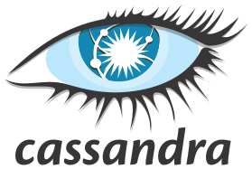






TOOLS USED

Slide 6
TOOLS USED
Data collection and storage is done through Kaggle,Excel spreadsheet and Mysql where Kaggle is a well-known platform for collecting, distributing, and analyzing datasets.
Cassandra: A NoSQL database designed for processing massive amounts of data over distributed clusters of machines. Cassandra is utilized in this workflow to generate a database and tables for storing the cleaned and modified data.
PySpark is a Python API for Apache Spark that allows developers to construct distributed data processing applications in Python. PySpark is used in this pipeline to integrate and convert data from many sources before preparing it for analysis.

Slide 7
Scikit-learn includes data preprocessing methods such as data scaling, normalization, and categorical variable encoding.
Apache Spark is a high-performance, general-purpose cluster computing system built for large-scale data processing. Apache Spark is utilized in this pipeline to clean, process, and analyze enormous amounts of data.
Colab offers data analysis and visualization tools, including popular Python libraries such as Pandas, Matplotlib, and Seaborn.
Matplotlib and Seaborn are Python libraries for making data visualizations. These libraries are used in this pipeline to create graphs, charts, and other visualizations to assist users better comprehend and analyze the data

Slide 8
TASKS/ANALYSIS
Data Collection
The "Human Resources Analytics" dataset, which is available on the Kaggle website at https://www.kaggle.com/ludobenistant/hr-analytics, was used to find the data.
The attributes and observations utilized in this dataset are purely made up in order to simulate a real-world scenario for a hypothetical corporation. 14,999 employee records are included in the number of observations from the dataset that is provided.
Python will be the programming language using for the analysis:
#Read the analytics csv file and store our dataset into a data frame called "df"
df = pd.DataFrame.from_csv('../input/HR_comma_sep.csv', index_col=None)

Slide 9
Data Preparation/Cleaning
Data preparation and cleaning are important steps in any data analysis project because they help ensure that the data is correct, consistent, and ready for analysis. Here are some specifics on the steps you mentioned:
Removing the duplicate columns: Duplicate columns should be removed because they can bias results or cause confusion during analysis. To eliminate duplicate columns, utilize Python's pandas module and the drop_duplicates() method.
Checking for missing values : Missing values can also pose problems during analysis because they might lead to inaccurate or biased results. You can use Python's pandas package and functions like isnull() and sum() to tally the number of missing values in each column to check for missing data.
Converting the categorical attributes: Many machine learning methods require numeric data, therefore categorical data must be transformed before analysis. You can use Python's pandas package and functions like factorize to transform categorical attributes to numeric data types.().
Renaming features: This can increase the clarity of your analysis by making them more descriptive and easier to grasp. To rename features, utilize Python's pandas package and the rename() method.

Slide 10
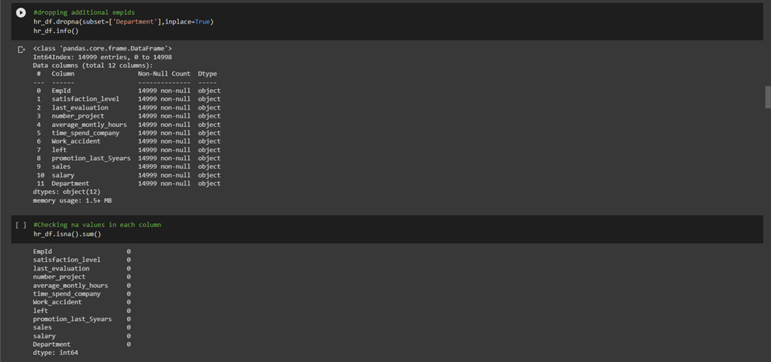
Removing duplicate values
Cleaning invalid numbers

Slide 11
Exploratory Data Analysis
Every data analysis effort must begin with exploratory data analysis (EDA). Through the use of statistical procedures and visual methods, the data must be examined and their key features summarized. We can use EDA to find patterns, connections, and anomalies in the data, which can direct future investigation and aid in our decision-making.
Summary Statistics :
Calculate the mean, median, and standard deviation for the numerical variables in the dataset.
Data visualization :
To display the distribution of the data and spot patterns and linkages, data visualization entails constructing plots and graphs. Pie charts, Histograms, bar graphs are a few examples of the common plot types used in EDA.

Slide 12
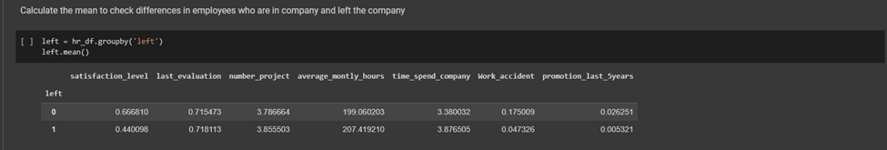
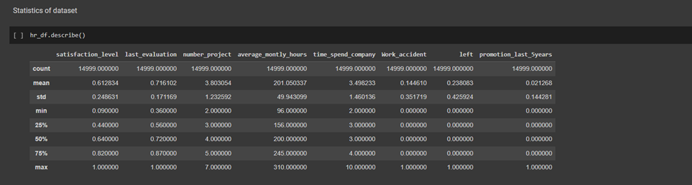
Statistical Overview :
Here are some crucial data points from the dataset to keep in mind:
- 14,999 workers and 9 independent factors
24 percent churn rate
Mean satisfaction: 0.61

Slide 13
Feature Selection: Select the most relevant features for predicting employee churn. This can be done using techniques such as correlation analysis, feature importance analysis, and principal component analysis. We don’t require all the attributes in the dataset for analysis. Since not all attributes can predict the churn of employees. For example, attributes like name, and email have no effect on an employee leaving the company.
Model Selection: Select the most appropriate machine learning algorithm for predicting employee churn based on the selected features. Popular algorithms for churn prediction include logistic regression, decision trees, random forests, and neural networks. Here, we use Logistic regression as the model.

Slide 14
Model Training and Evaluation: Train the selected model on the training data and evaluate its performance on the validation data. In this project, we used the Logistic Regression model. Which takes 70% dataset for training and 30% to test the results. We used evaluation metrics such as accuracy, precision, recall, and Model score
Model Optimization: Optimize the selected model by tuning its hyperparameters and re-evaluating its performance on the validation data.
Visualization: We visualize the results that are obtained from the model. We also visualize the relations between the various attributes in the dataset. We used Seaborn, and matplotlib to visualize the dataset and results.

Slide 15
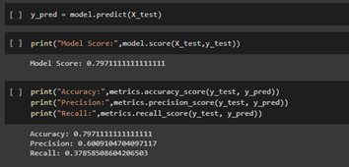
RESULTS
Test evaluation
Model Score (Accuracy) = (Number of Correct Predictions) / (Total Number of Predictions)
Precision = (Number of True Positives) / (Number of True Positives + Number of False Positives)
Recall = (Number of True Positives) / (Number of True Positives + Number of False Negatives)

Slide 16
Video link
https://drive.google.com/file/d/1kGE0vX-RD8V1AKSdcx57_CtS5zJogRW1/view?usp=sharing

